Slide 1

Yahoo’s Information Security Design
By: Koo Wai Kit (TP081761)
Notes:
Today, I will be presenting the findings of my research on ….
The aim of this research is to examine Yahoo’s current information security design, identify key vulnerabilities and risks, and propose targeted improvements to address these weaknesses.

Slide 2
Content
01
02
03
04
Yahoo Overview
Yahoo’s Current Information Security Design
Yahoo’s Security Challenges
05
06
Identified Gaps in Yahoo's Security Design
Proposed Solutions
Conclusion & QnA

Slide 3
01
Yahoo Overview
Company Profile
Current Business Focus
Organizational Structure

Slide 4
Company Profile
In the 1990s and early 2000s, it is one of the most prominent and popular web services provider.
Originally named "Jerry and David’s Guide to the World Wide Web“
Later rebranded as Yahoo! → acronym for “Yet Another Hierarchical Officious Oracle”
With the rise of tech giants like Google, Yahoo struggled to compete, which led to its downfall.
1994
2017
2021
Founded by Jerry Yang and David Filo
Acquired by Verizon Communications
Operates under Oath Inc.
Later renamed as Verizon Media
Acquired by Apollo Global Management (90% of Yahoo)
Renamed as Yahoo Inc.

Slide 5
Current Business Focus
Digital Advertising
Subscription Services
Yahoo Mail
Through its demand-side platform (DSP), known as Yahoo Advertising
E.g., Yahoo Finance Premium
Has been enhanced into a "super-app“, includes features like personalised shopping offers

Slide 6
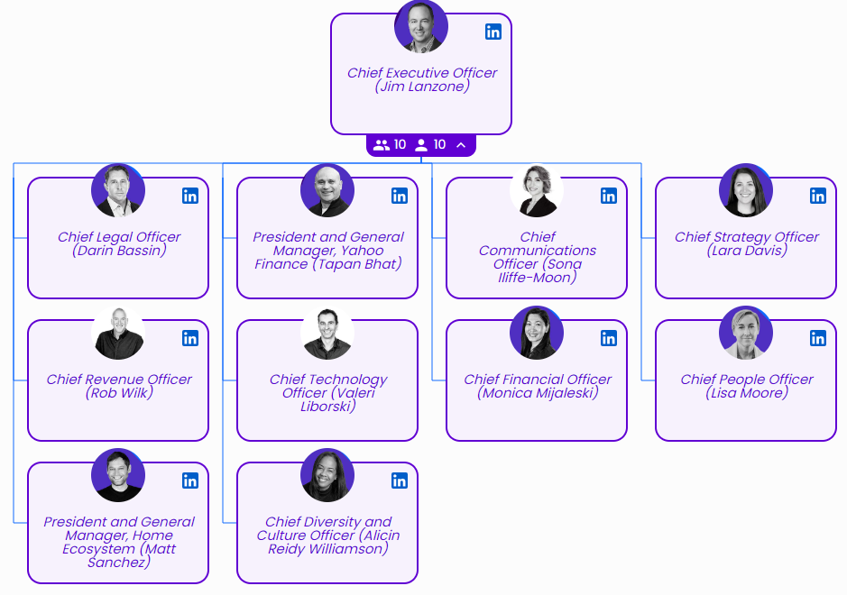
Organizational Structure
Operates from 24 global offices.
Approximately 8,000 employees as of 2023.
Has a dedicated information security team known as the "Paranoids".
Leadership Team

Slide 7
02
Yahoo’s Current Information Security Design
Compliance Status
Information Security Program
Principles Guiding Security Framework

Slide 8
Compliance Status
ISO 27001/27005: Used in information security risk management.
NIST CSF: Aligns security policies for threat detection and response.
NIST 800-30: Guides risk assessments.
NIST SP 800-53: Secures data centers and physical environments.
GDPR: Enforces data privacy for EU users.
HIPAA: Protects sensitive healthcare information in the USA.
PCI DSS: Secures payment card data.
SCCs: Ensures compliance for international data transfers.
SOC2: Evaluates internal controls for data security, availability, and confidentiality.
Notes:
Industry standards and regulatory requirements

Slide 9
Information Security Program
Encryption
Employs industry-standard encryption
Access Control
Strict access control for corporate systems and remote access
System Maintenance
Conducts regular vulnerability assessments, code reviews, and a public bug bounty program
Security Monitoring and Incident Response
Operates a Security Operations Center (SOC) with established incident response procedures and threat intelligence updates
Organizational Security
Enforces security policies for all employees and conducts risk assessments and security consulting
Encrypts critical products and services
Physical and Environmental Security
Protects physical infrastructure through architectural controls and continuous threat monitoring
Personnel Security
Mitigates insider threats with RBAC, MFA, background checks, and annual security training
Network Security
Implements a zero-trust model with perimeter defense, standardized configurations, and regular risk assessments
Cloud Security
Ensures data protection via identity management, logging, secure networking, application protection, and encryption
Mobile Security
Enforces policies for mobile devices, e.g., secure SDK integration and mobile device management (MDM)

Slide 10

Principles Guiding Yahoo’s Security Framework
Asset Classification and Control
Tracks and classifies assets based on criticality, applying necessary safeguards
Risk Management
Identifies and prioritizes threats using a risk-driven strategy aligned with NIST 800-30
Vulnerability Management
Regularly scans and updates software to identify and remediate vulnerabilities
Operations Management
Controls changes through a centralized system with impact analysis and testing
Business Continuity Planning
Ensures minimal disruptions through global redundancy and continuous monitoring
Secure Software Development
Integrates security into the software development lifecycle with training and testing
Compliance and Governance
Aligns security policies with industry standards and ensure regulatory compliance
Transparency
Commits to inform users of state-sponsored attacks and breach notifications promptly

Slide 11
03
Yahoo’s Security Challenges
Past Security Incidents
Past Vulnerabilities
Current Vulnerabilities

Slide 12
Past Security Incidents
2013 Breach
2014 Breach
Compromise all 3 billions user accounts on Yahoo’s servers
Attributed to an unauthorized third-party accessing Yahoo's servers
Yahoo only became aware of the breach after been notified by law enforcement
Compromise over 500 million user accounts
Attributed to weak encryption practices and phishing emails
Yahoo knew about the breach in 2014, but did not reveal it to the public until 2016
Exposed:
Names, email addresses, phone numbers, birth dates, encrypted and unencrypted security questions

Slide 13
Past Security Vulnerabilities
Weak encryption practices, including the use of the outdated MD5 algorithm
Insufficient cybersecurity investment and a reactive security approach
Poor internal communication and reporting of security incidents
Inadequate monitoring and incident response capabilities.

Slide 14
Current Security Vulnerabilities
Website
Unsafe Content Security Policy (CSP) configurations
Email
Weak Sender Policy Framework (SPF) implementation
Critical flaws in Yahoo Mail's attachment scanning, malicious files can bypass security measures
DNS
Lack of DNS Security Extensions (DNSSEC)
Encryption
Support insecure SSL/TLS versions
Expiring SSL certificate
Weak cipher suites in TLS 1.2
Lack of essential HTTP Strict Transport Security (HSTS) protections
Domain is missing from the HSTS preload list

Slide 15
04
Gaps in Yahoo’s Current Information Security Design

Slide 16
Gaps in Yahoo’s Current Information Security Design
(A) Prioritizing Usability and Profitability over Security
Lack of balance between user experience and robust security measures.
(B) Insufficient Cybersecurity Investment
No clear strategy for resource allocation or scaling the security team.
(C) Weak Encryption Practices
Slow upgrade and phase-out of outdated encryption methods.
(D) Ineffective Vulnerability and Patch Management
Delays in patching known vulnerabilities.
(E) Website and Email Security Issues
Lack of continuous hardening measures beyond basic encryption and access control.
(F) Insufficient Focus on Insider Threats
Gaps in detecting and preventing insider threats.
(G) Poor Communication
Inadequate communication efforts between security teams and management.
(H) Inadequate Monitoring and Detection
Lack of advanced monitoring tools and real-time threat detection capabilities.

Slide 17
05
Proposed Solutions to Address the Gaps
Strengthening Security Posture
Proactive Vulnerability Management and Personnel Security
Enhancing Communication and Response

Slide 18
Solutions: Strengthening Security Posture
(A) Balance Usability and Security
1) Design a more user-centric authentication methods and streamline security processes.
2) Use behavioural analytics to detect anomalies while minimizing friction for legitimate users.
(B) Cybersecurity Investment and Resource Allocation
1) Develop a cybersecurity budget aligned with risk assessments.
2) Implement more automation and advanced security technologies.
3) Foster a culture of security awareness through training and education.
(C) Upgrade and Phase Out Outdated Encryption
1) Establish an encryption policy lifecycle with regular reviews and sunset plans.
2) Prioritize strong encryption (e.g., AES) for sensitive data and implement end-to-end encryption.

Slide 19
Solutions: Proactive Vulnerability Management and Personnel Security
(D) Rapid Patch Deployment and Vulnerability Remediation
1) Accelerate patch deployment through automation.
2) Establish clear SLAs (Service Level Agreements) for vulnerability remediation based on severity.
3) Address security risks associated with legacy systems.
(E) Continuous Website and Email Security Hardening
1) Automate security hardening tasks within CI/CD pipelines.
2) Establish a patch management process for third-party components.
(F) Strengthening Personnel Security and Addressing Insider Threats
1) Implement a comprehensive insider threat program.
2) Transition to a Zero Trust security model with PAM (Privileged Access Management).
3) Establish clear data handling policies, procedures, and monitoring systems.

Slide 20
Solutions: Enhancing Communication and Response
(G) Improve Communication Between Security Teams and Management
1) Establish clear communication channels and reporting schedules.
2) Develop a common cybersecurity language and standardized reporting framework.
(H) Enhance SOC Capabilities and Threat Detection
1) Provide SOC analysts with advanced training and skills development.
2) Conduct regular testing and evaluation of monitoring tools and response procedures.

Slide 21
06
Conclusion & QnA

Slide 22

Conclusion
Yahoo faces ongoing security challenges from past incidents and evolving threats.
A proactive security approach is essential.
Proposed solutions will:
address vulnerabilities and enhance security
ensure industry standard compliance
protect user data and restore trust
A strong, adaptable security framework is key to Yahoo’s long-term success.

Slide 23


Yahoo’s Information Security Design
Any Questions?
Thank You

